Slide 1
geophysical electromagnetics imaging the subsurface from shallow to deep
Lindsey Heagy
University of British Columbia -- Geophysical Inversion Facility

Slide 2
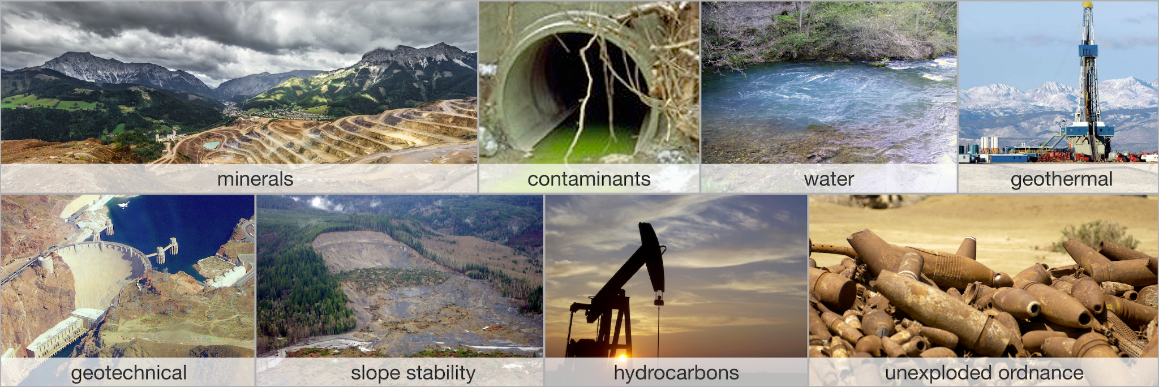
some important problems
have in common: need to (non-invasively) image the subsurface

Slide 3
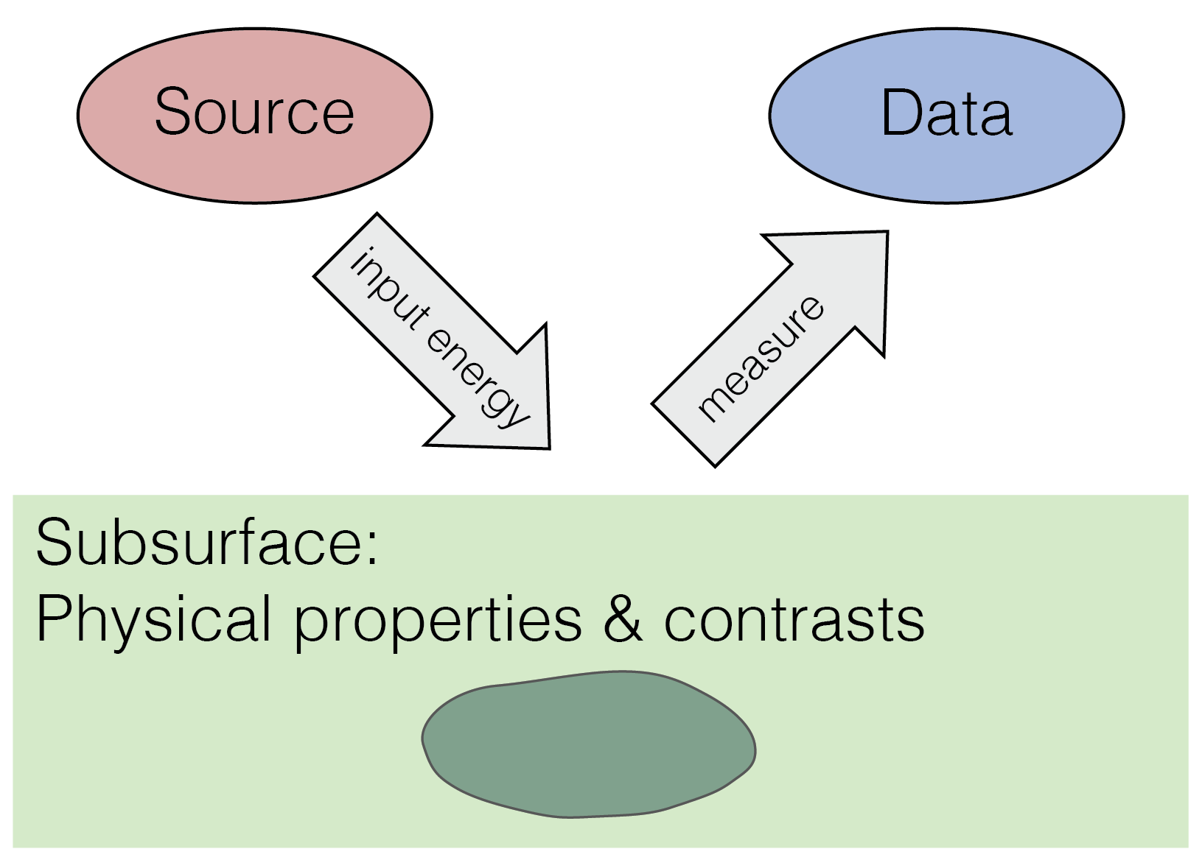
geophysical experiments & physical properties
physical properties are intrinsic to a material (density, susceptibility, conductivity…)

Slide 4
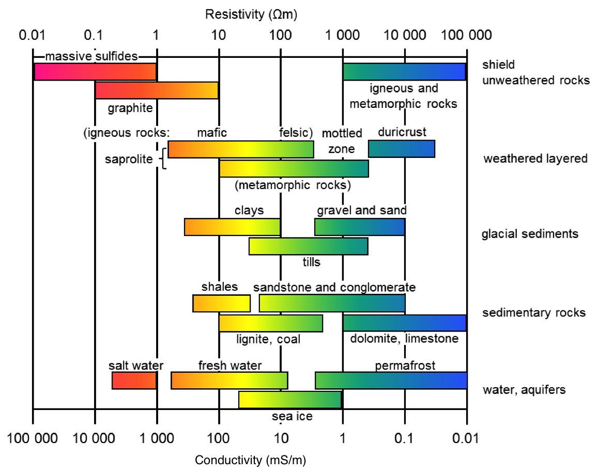
electrical conductivity / resistivity
A measure of how easily current passes through a material
σ: conductivity [S/m]
ρ: resistivity [Ωm]
ρ = 1/σ
Depends on many factors
Mineralogy
Porosity
Permeability
Nature of pore fluid

Slide 5
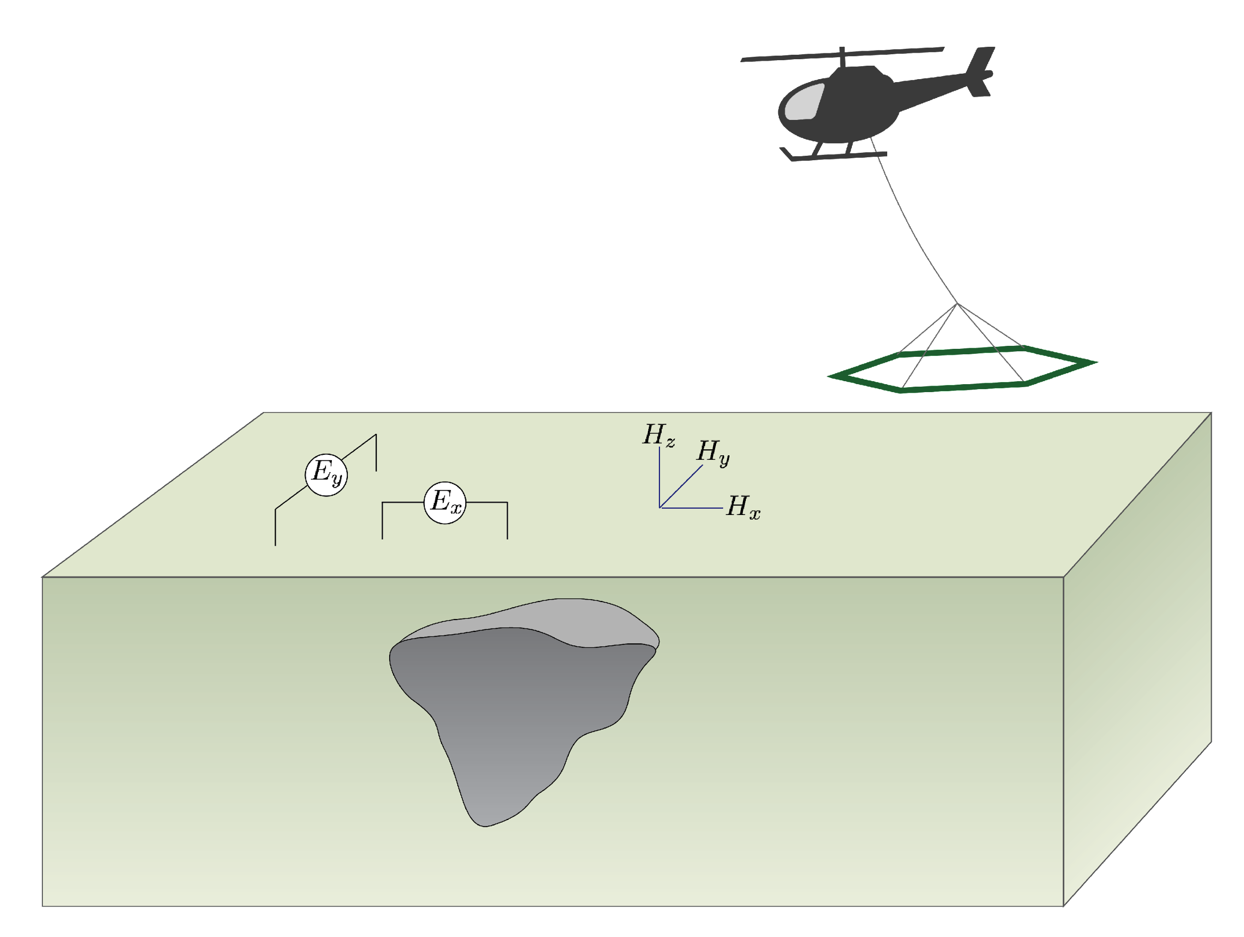
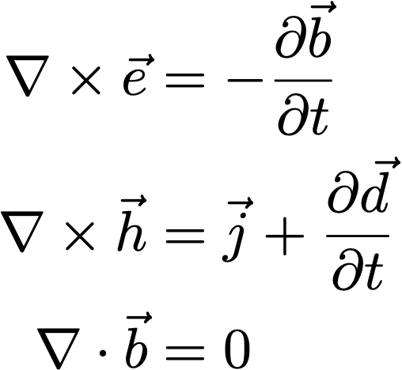
electromagnetic experiments
Sources:
grounded or inductive
controlled or natural
Waveform
harmonic (FDEM)
transient (TDEM)
Survey location
airborne
ground
boreholes

Slide 6
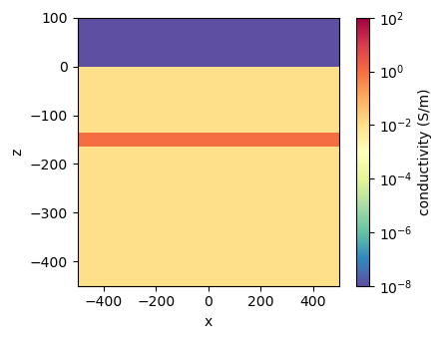
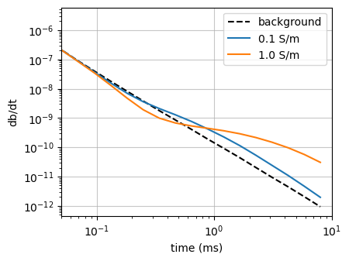
inductive sources: time-domain
air: 10⁻⁸ S/m
layer
background: 10⁻² S/m

Slide 7
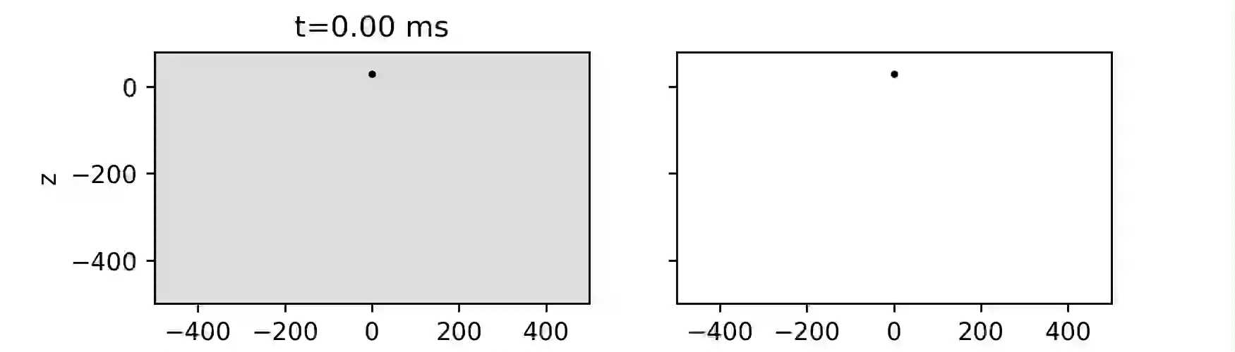
inductive sources: time-domain
current density
db/dt

Slide 8
inductive sources: time-domain
current density
db/dt

Slide 9
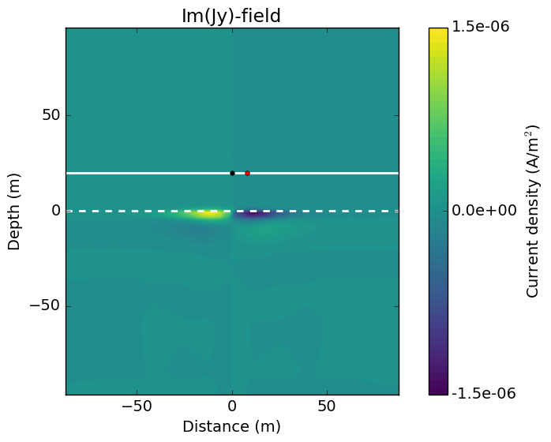
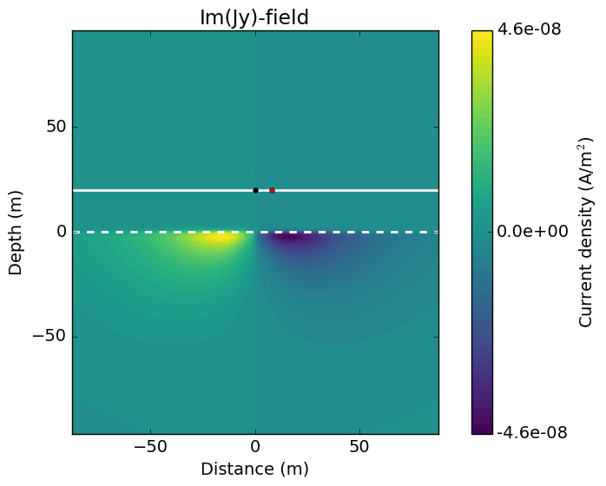
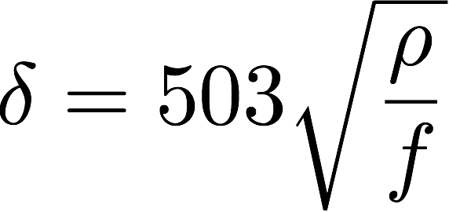
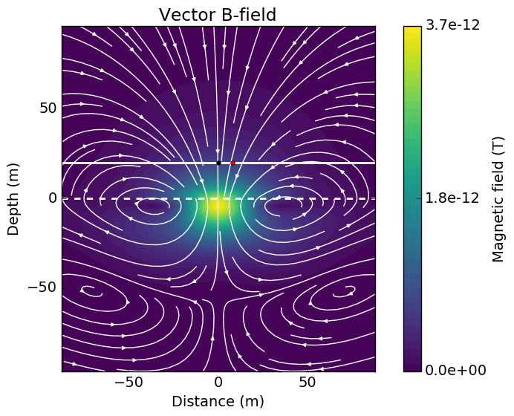
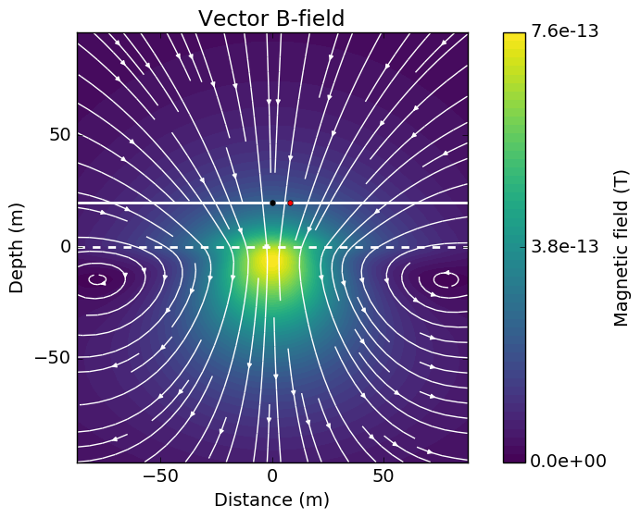
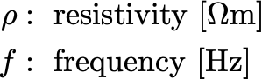
physics: frequency domain
high frequency ~ early times, low frequency ~ later times
100 kHz
10 kHz
J_{y} imag
skin depth
B imag

Slide 10
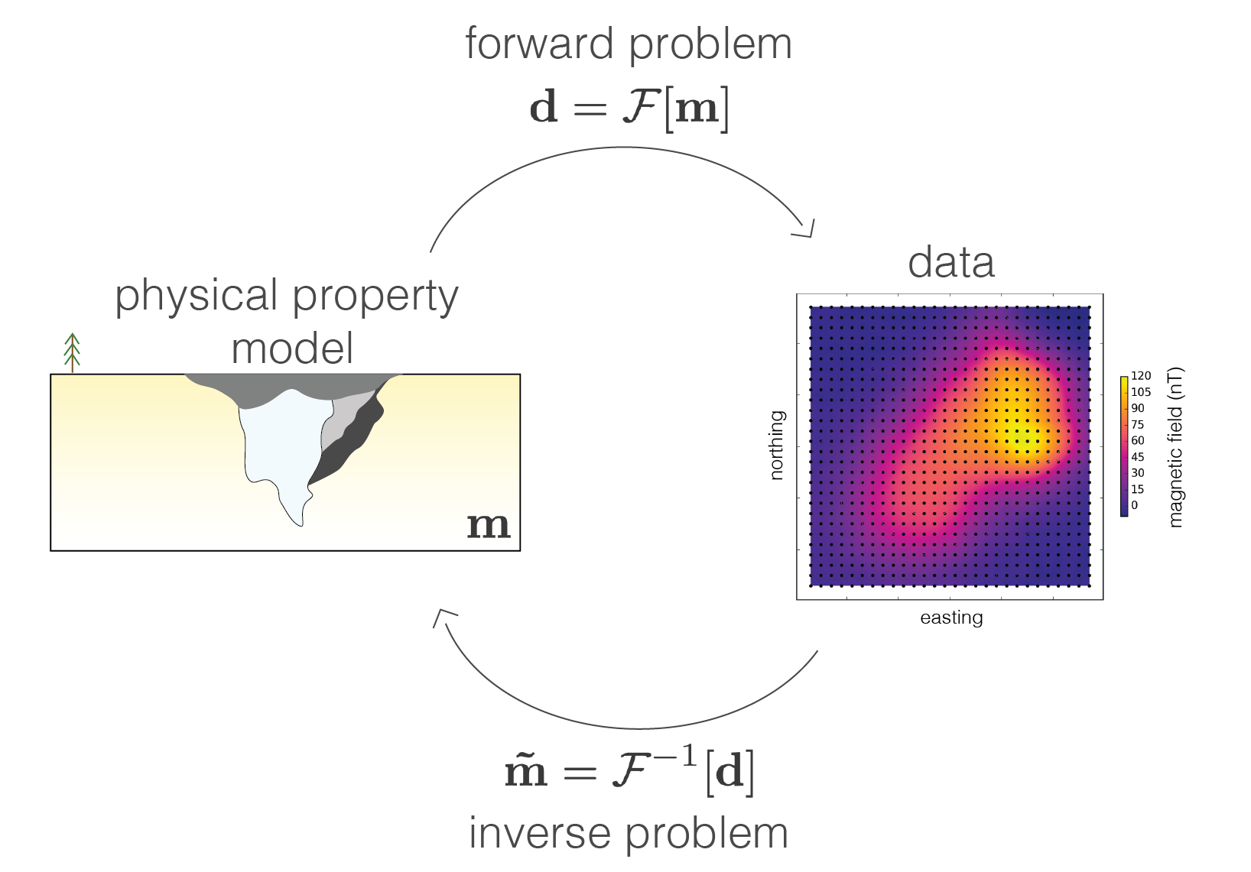
forward and inverse problems

Slide 11
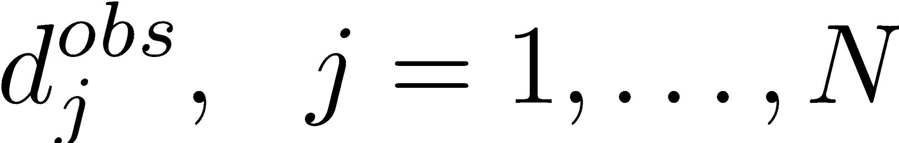

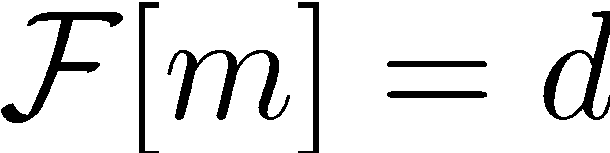
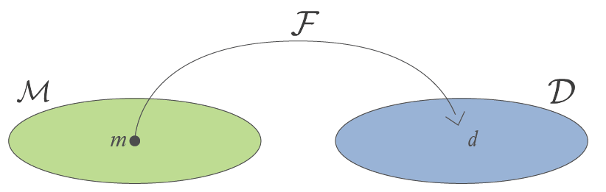
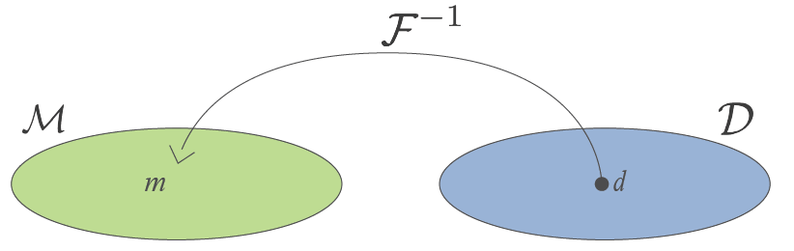
statement of the inverse problem
Given
observations:
uncertainties:
ability to forward model:
Find the Earth model that gave rise to the data

Slide 12
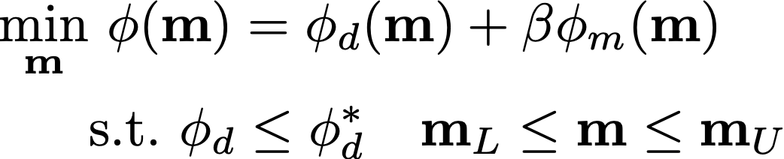
statement of the inverse problem
Given
observations:
uncertainties:
ability to forward model:
Inverse problem: Find an Earth model that fits those data and a-priori information

Slide 13

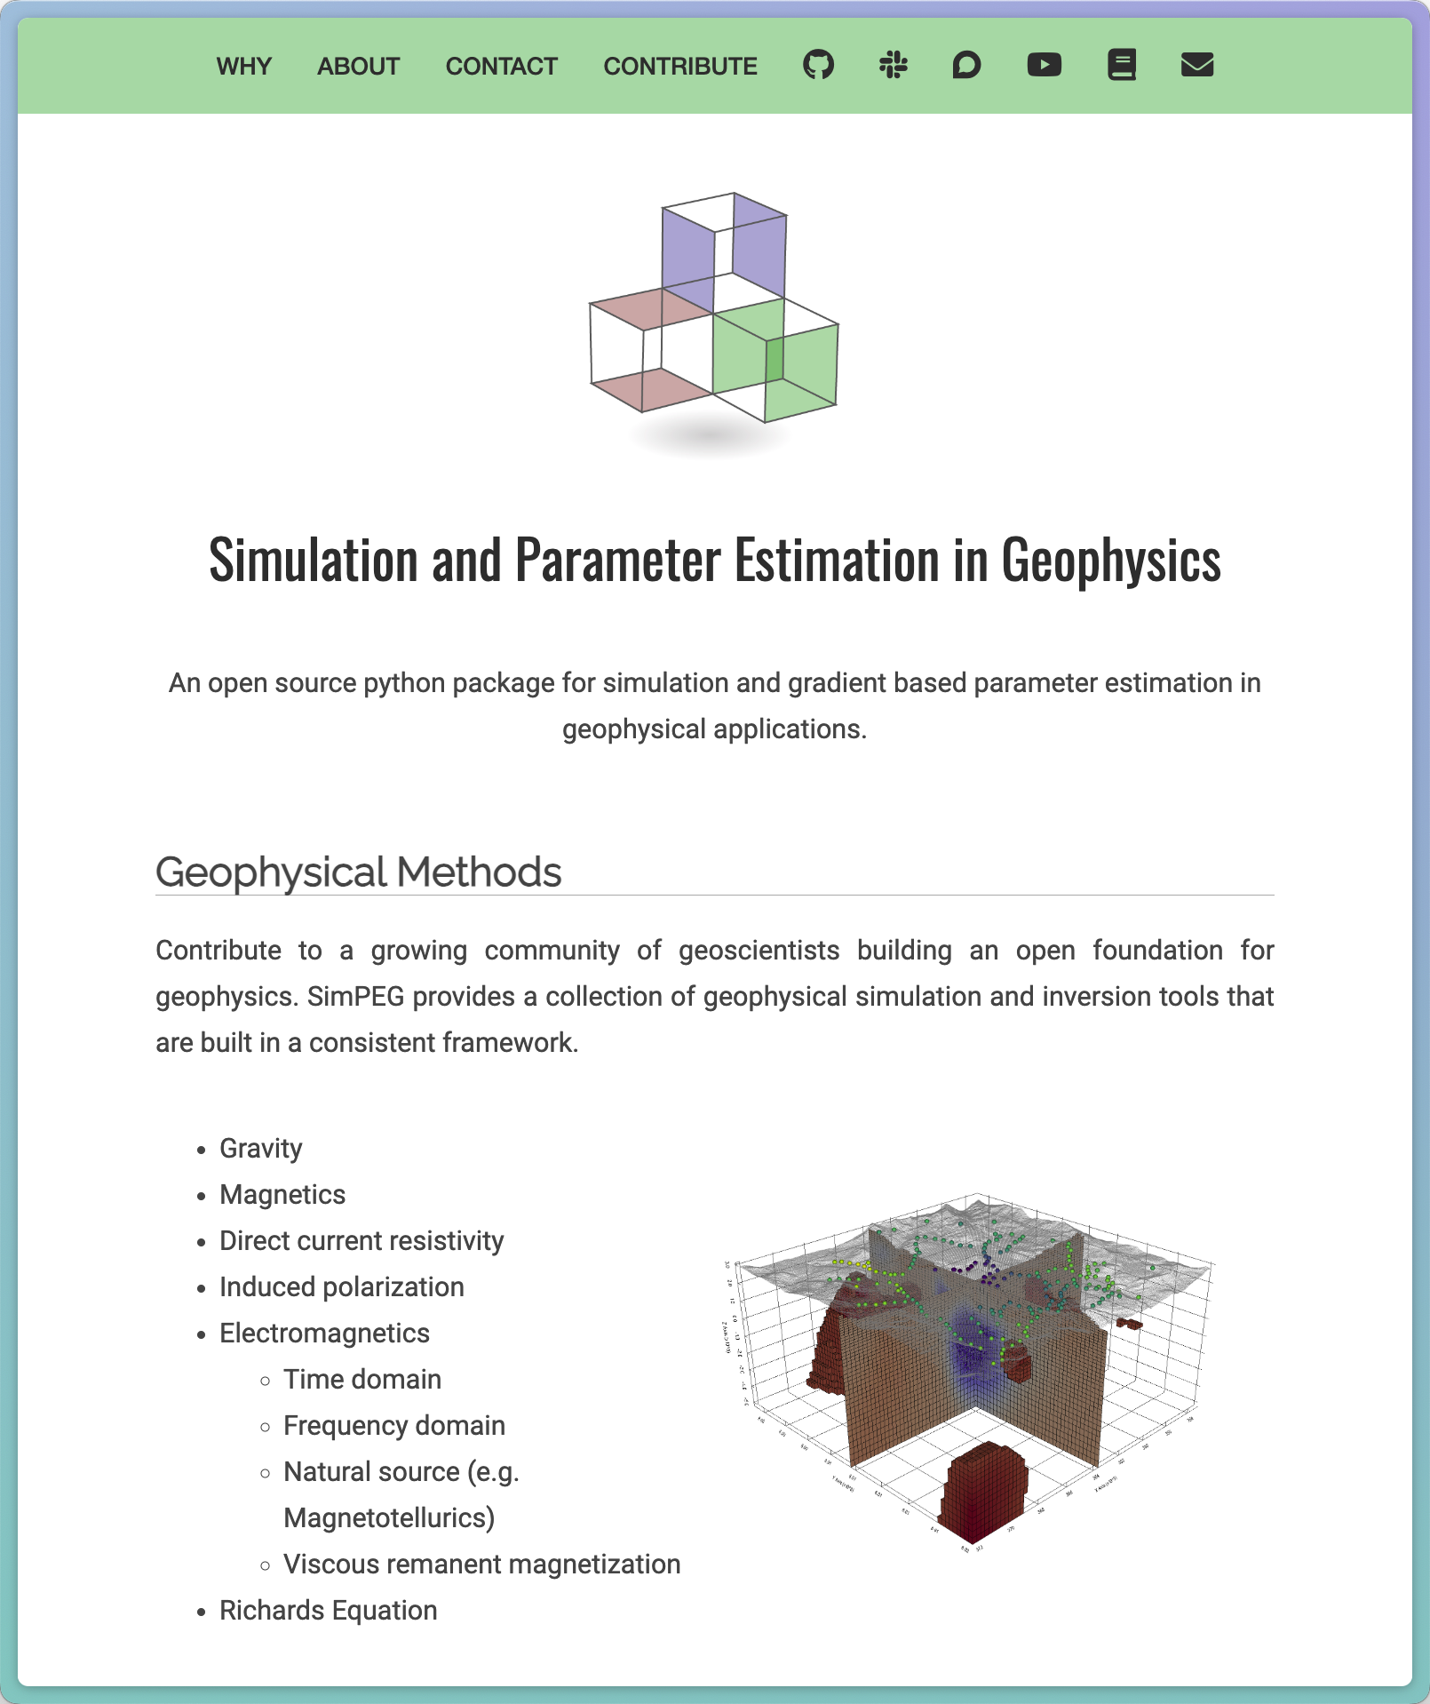
Simulation and parameter estimation in geophysics
common framework for simulations & inversions
accelerate research: build upon others work
facilitate reproducibility of results
build & deploy in python
open-source
https://simpeg.xyz

Slide 14

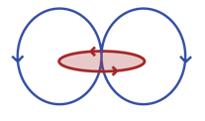
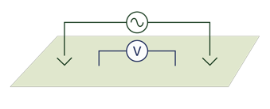
Multi-scale EM geophysical methods
Controlled-source EM
Natural source EM
Inductive
Grounded
Depth from the surface
meters
Tens of meters
Hundreds of meters
Kilometers
Tens of kilometers
Hundreds of kilometers

Slide 15
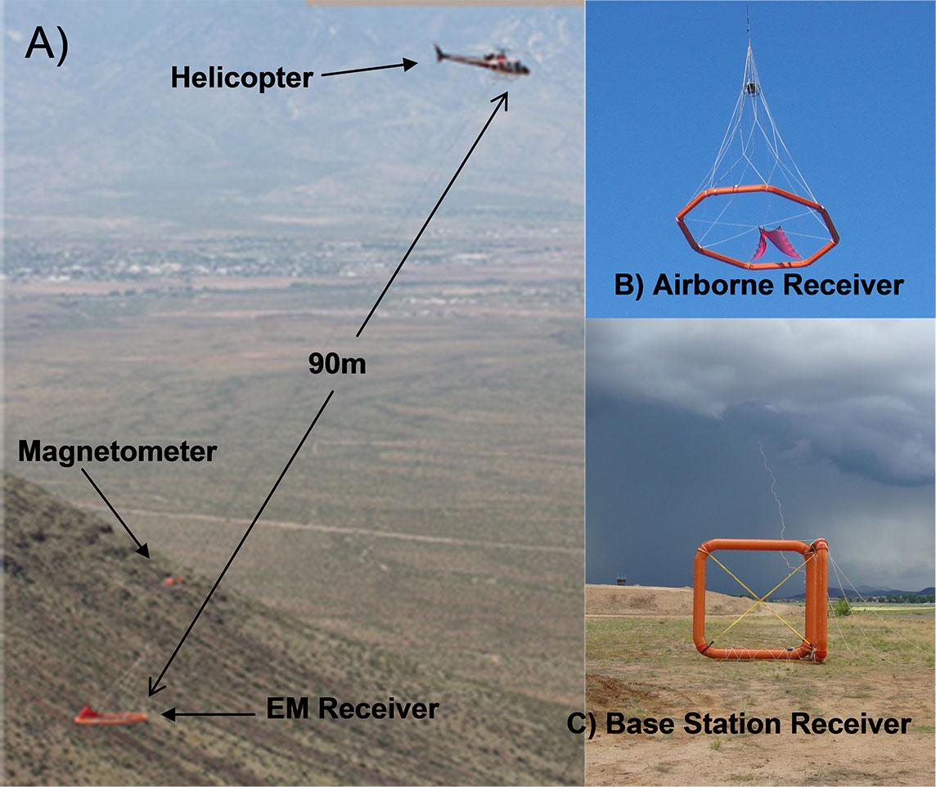
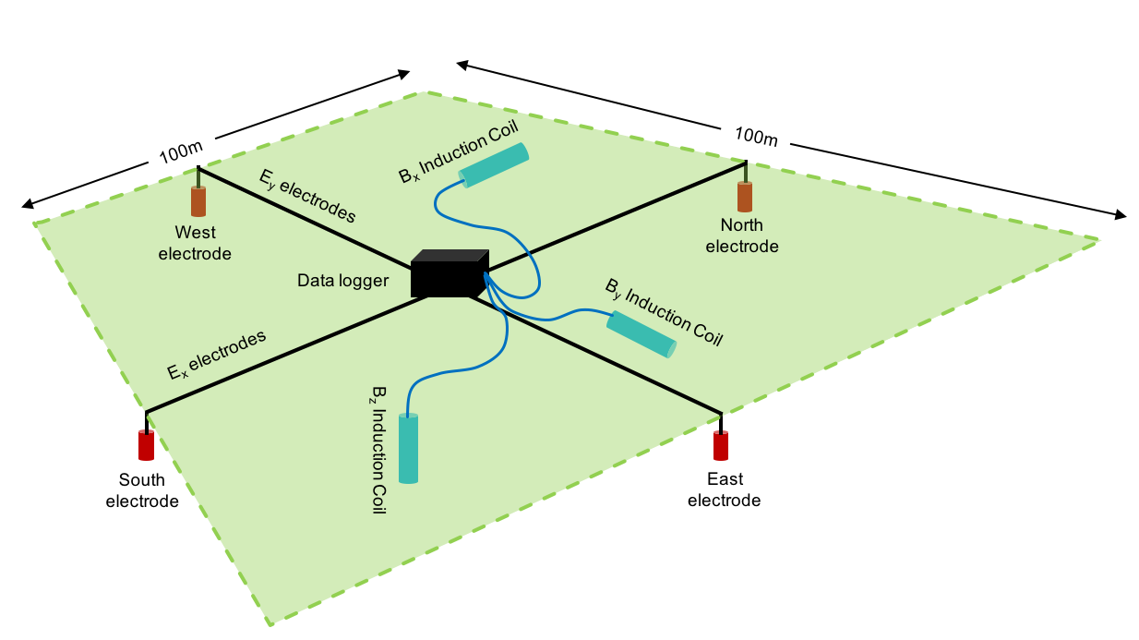
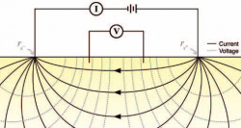
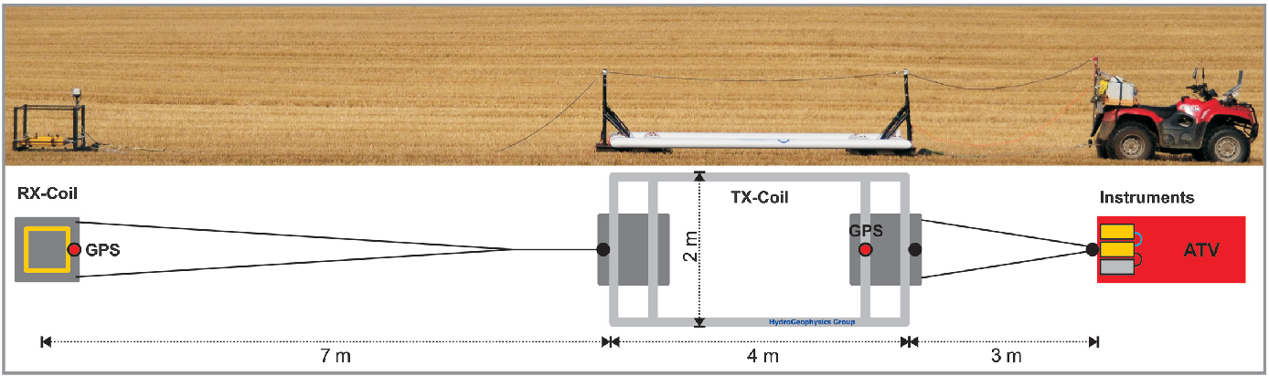
Multi-scale EM geophysical methods
Controlled-source EM
Natural source EM
Inductive
Grounded
Depth from the surface
meters
Tens of meters
Hundreds of meters
Kilometers
Tens of kilometers
Hundreds of kilometers
Ground-based EM
Airborne EM (AEM)
Z-axis Tipper EM (ZTEM)
Magnetotellurics (MT)
ERT
Towed-TEM

Slide 16
important problems: scales and surveys

Slide 17
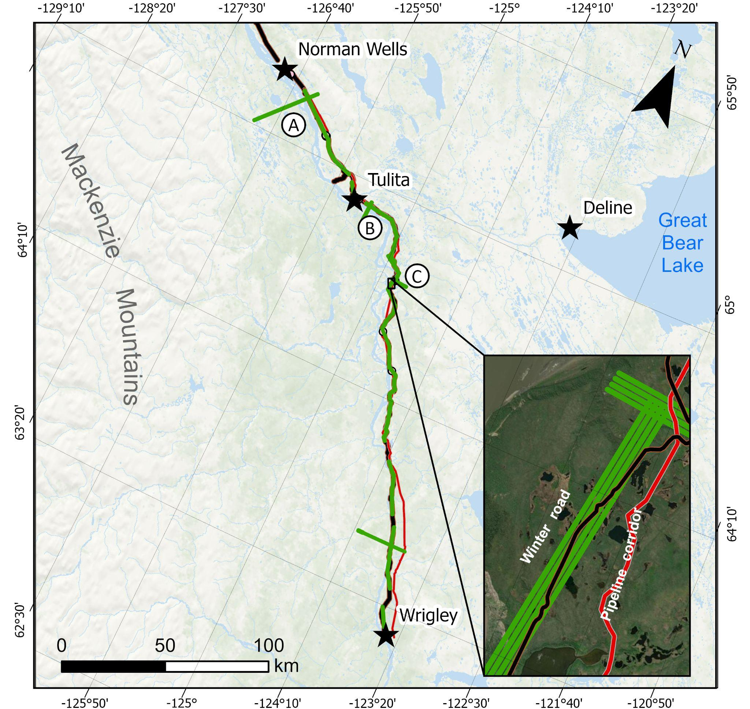
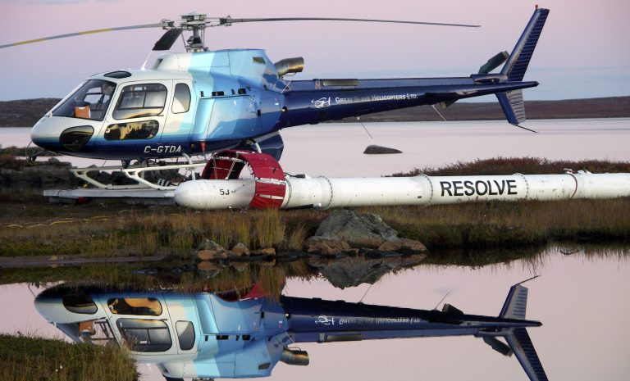
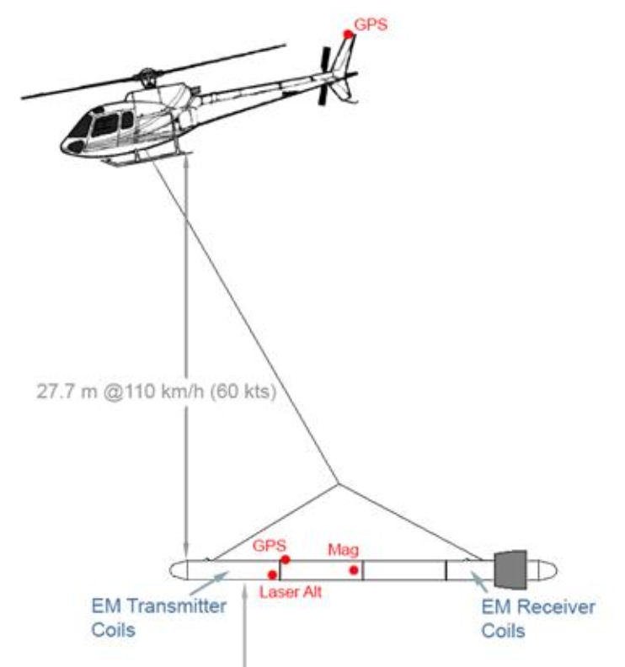
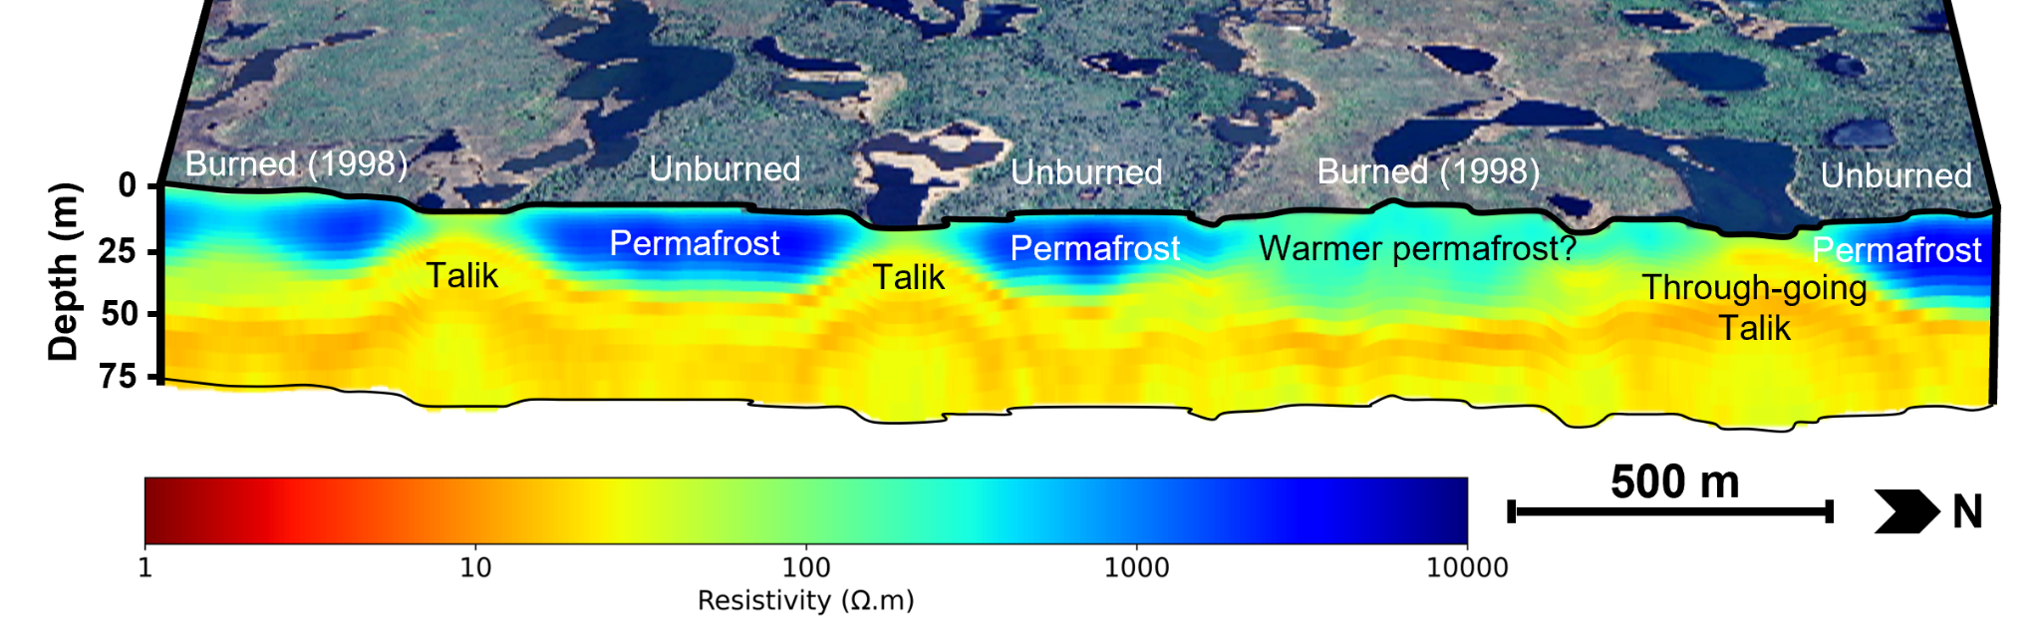
permafrost: near surface, large areas
Airborne : cover large areas
Frequency-domain EM system (400Hz – 135k Hz)
(Froese et al., 2024, Moshtaghian et al., 2024)

Slide 18
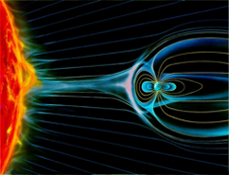
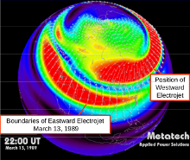
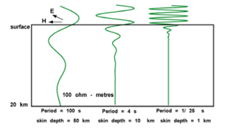


minerals, geothermal: large scales & seeing deep
natural source: rely on lightning strikes, solar wind as our source (unknown strength)
skin depth (m)
lightning
aurora

Slide 19
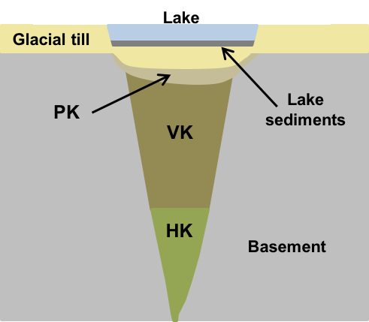
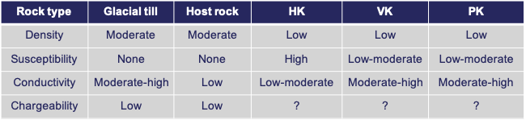
minerals: intermediate scale, multiple data types
Diamond exploration: rock units identified using multiple physical properties
Devriese et al. 2017, Fournier et al. 2017, Kang et al. 2017

Slide 20
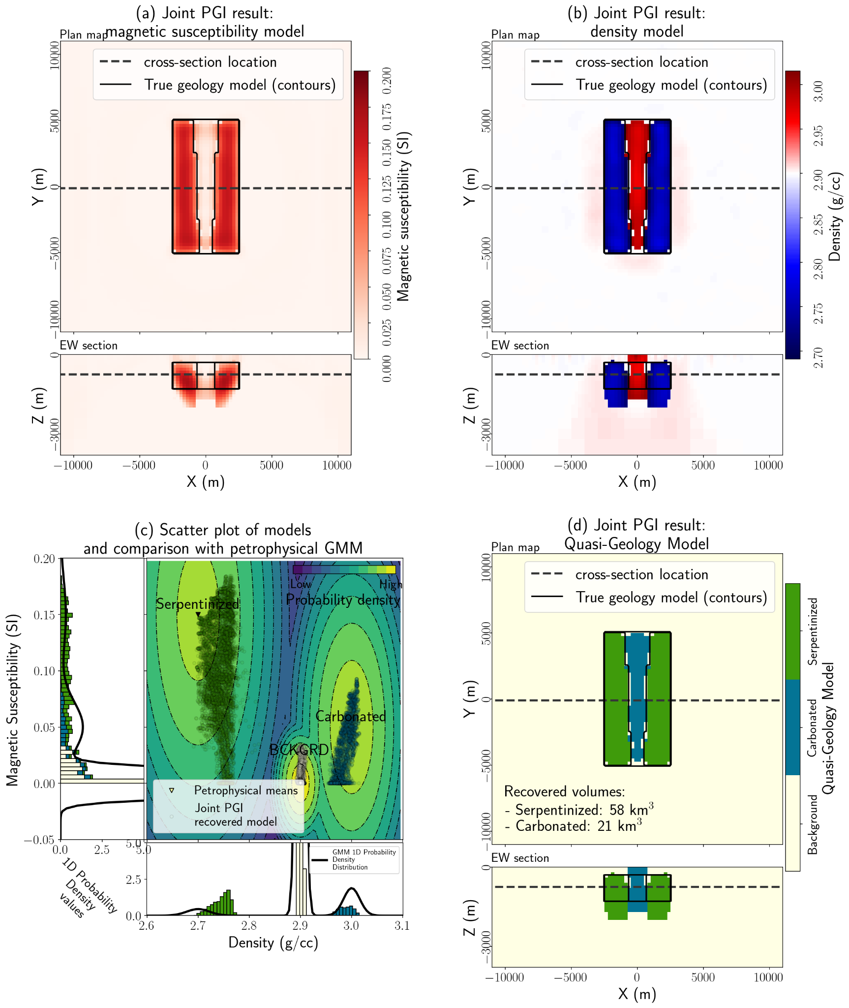
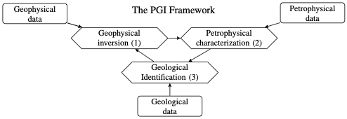
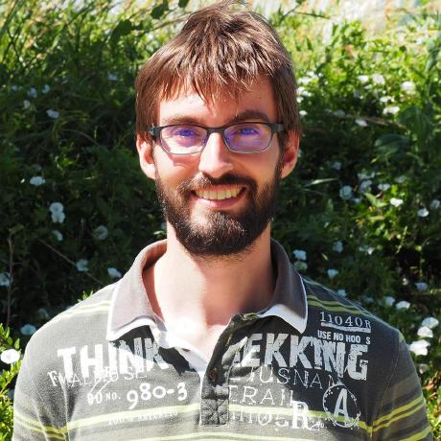
minerals: intermediate scale, multiple data types
Petrophysically and Geologically Guided Inversion
brings in petrophysical information (GMM)
builds a quasi-geology model
important components in the inversion
multiple data misfits
including petrophysical information
T. Astic

Slide 21
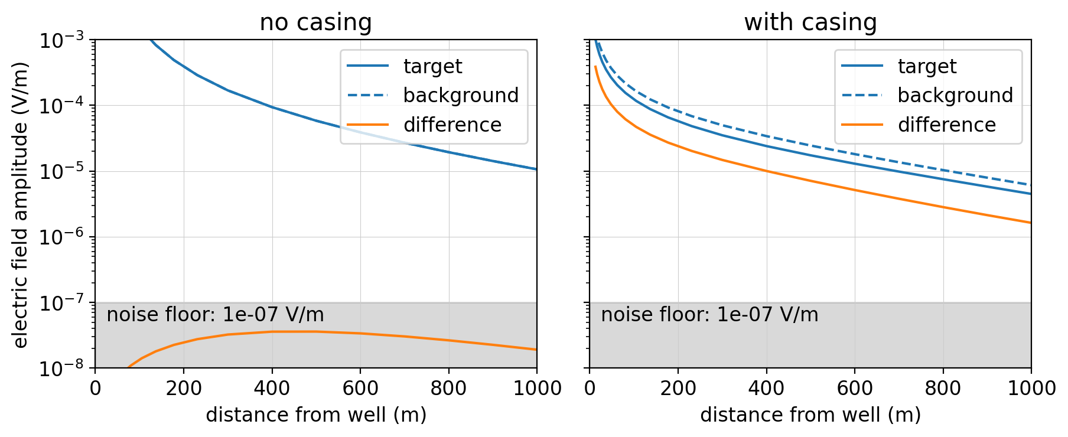
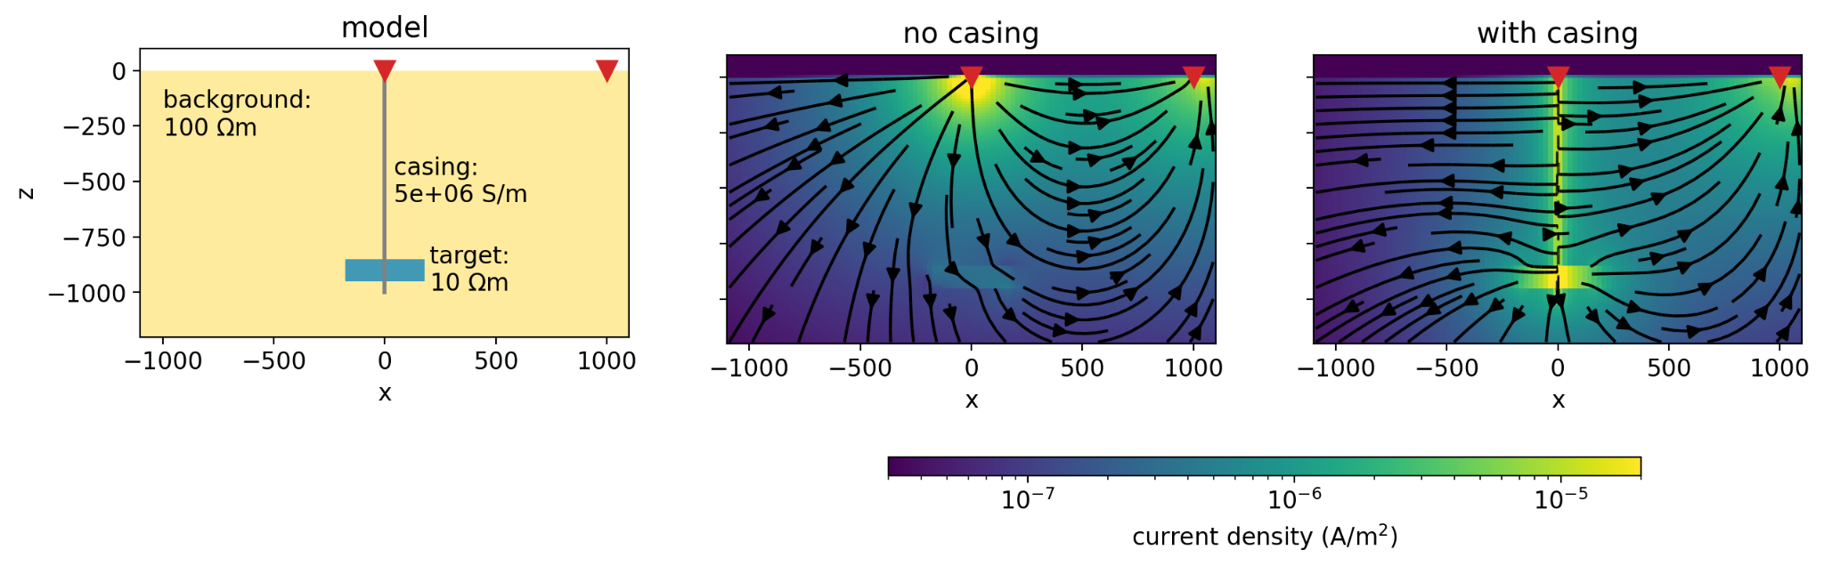
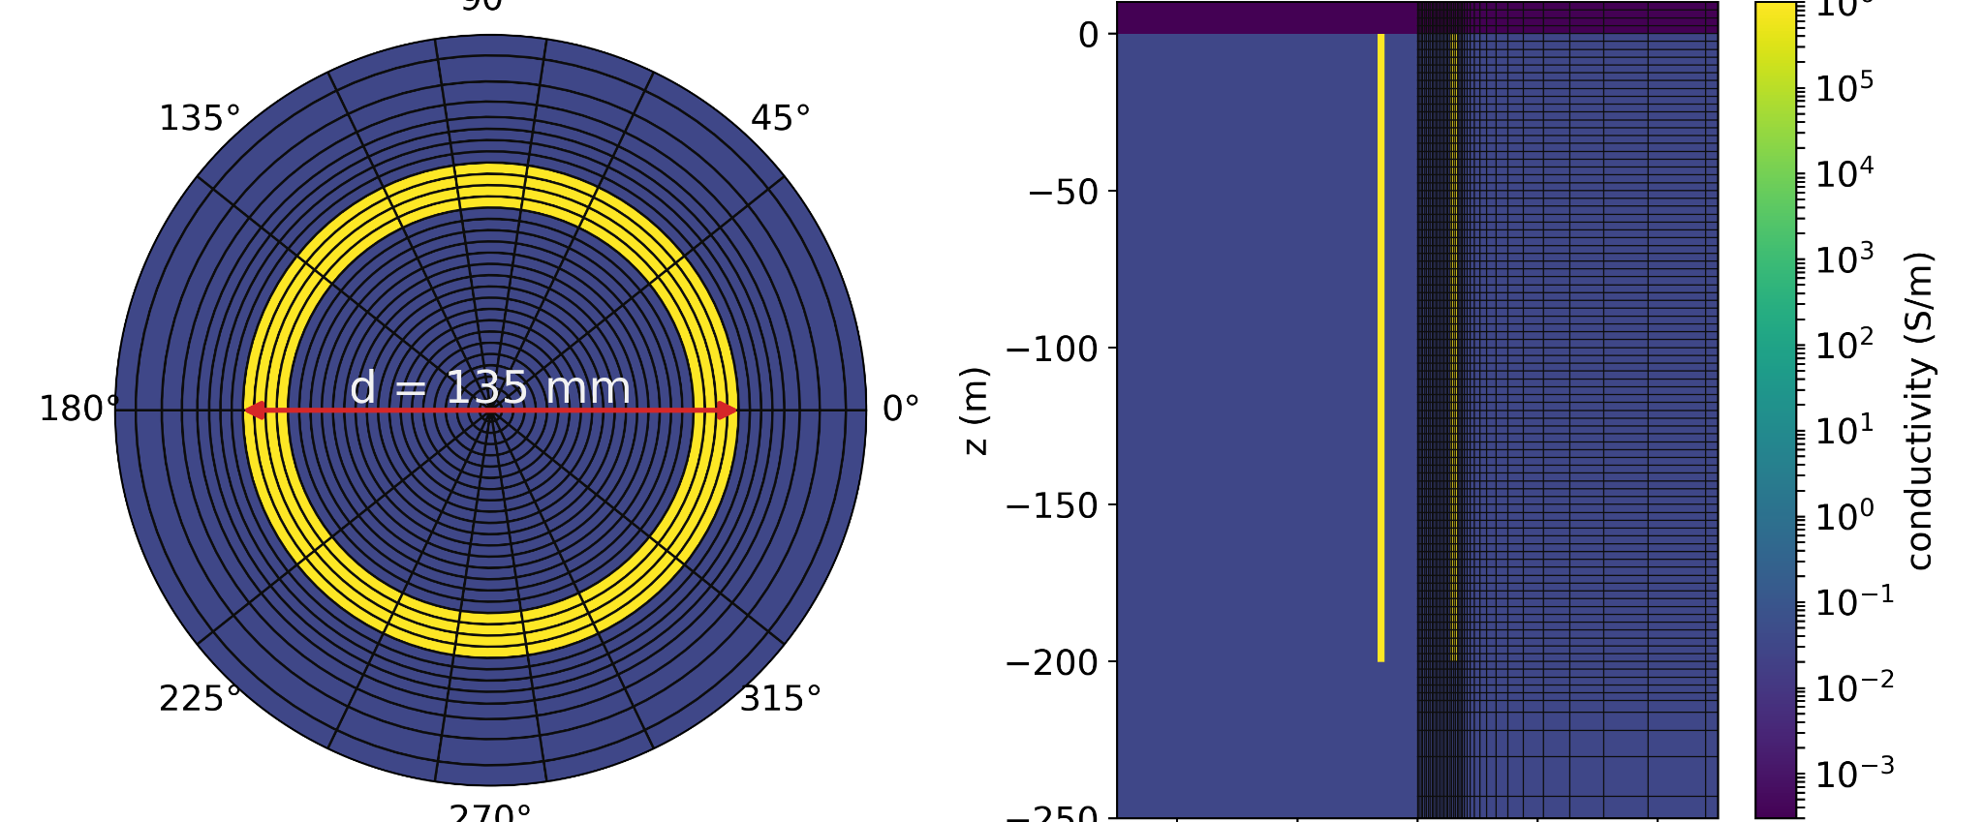
CO₂ sequestration, hydrocarbons: fine scales & large contrasts
steel casings: highly conductive, magnetic
grounded sources: helpful for exciting & detecting deep targets

Slide 22
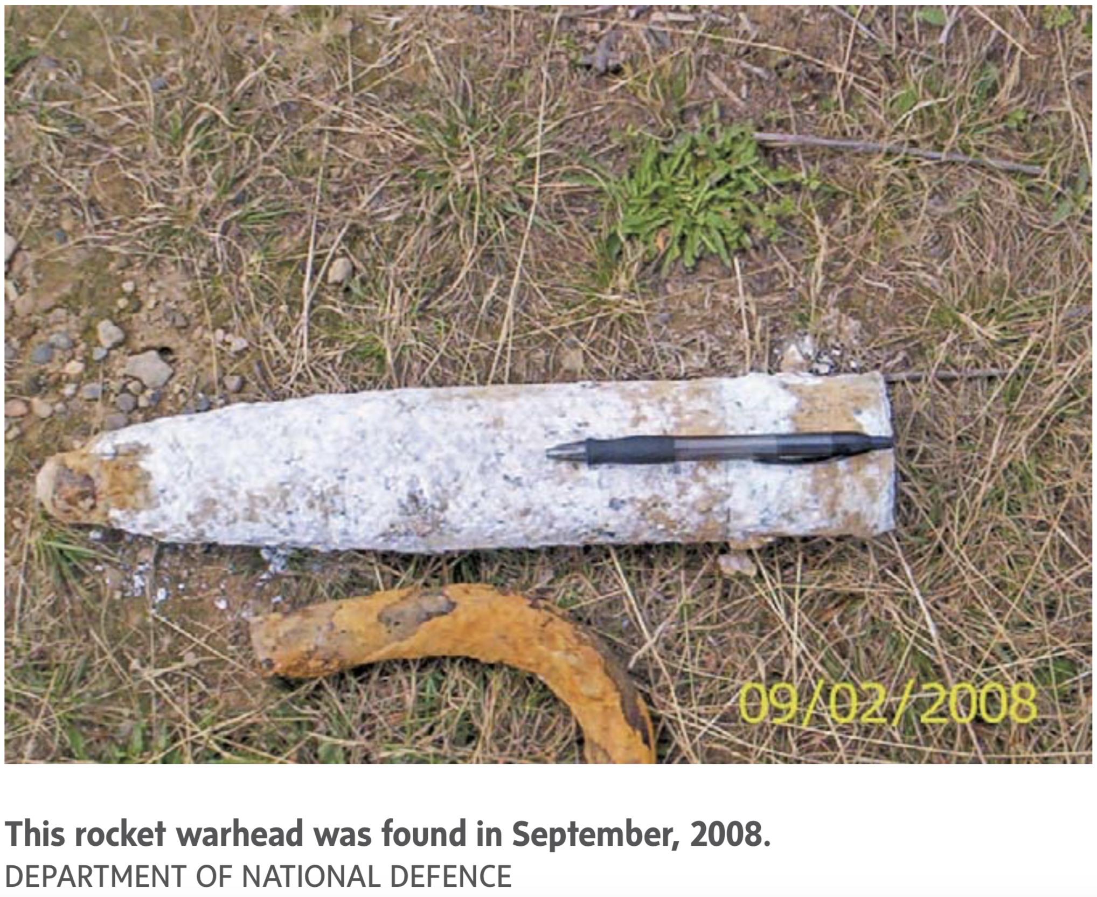
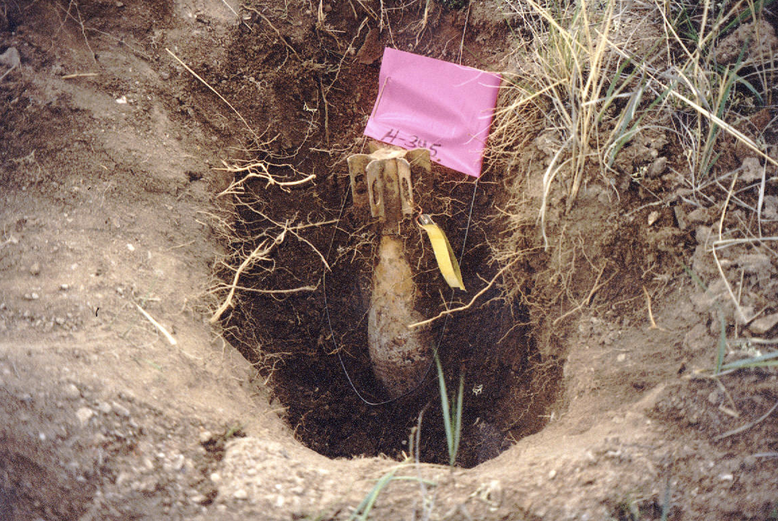
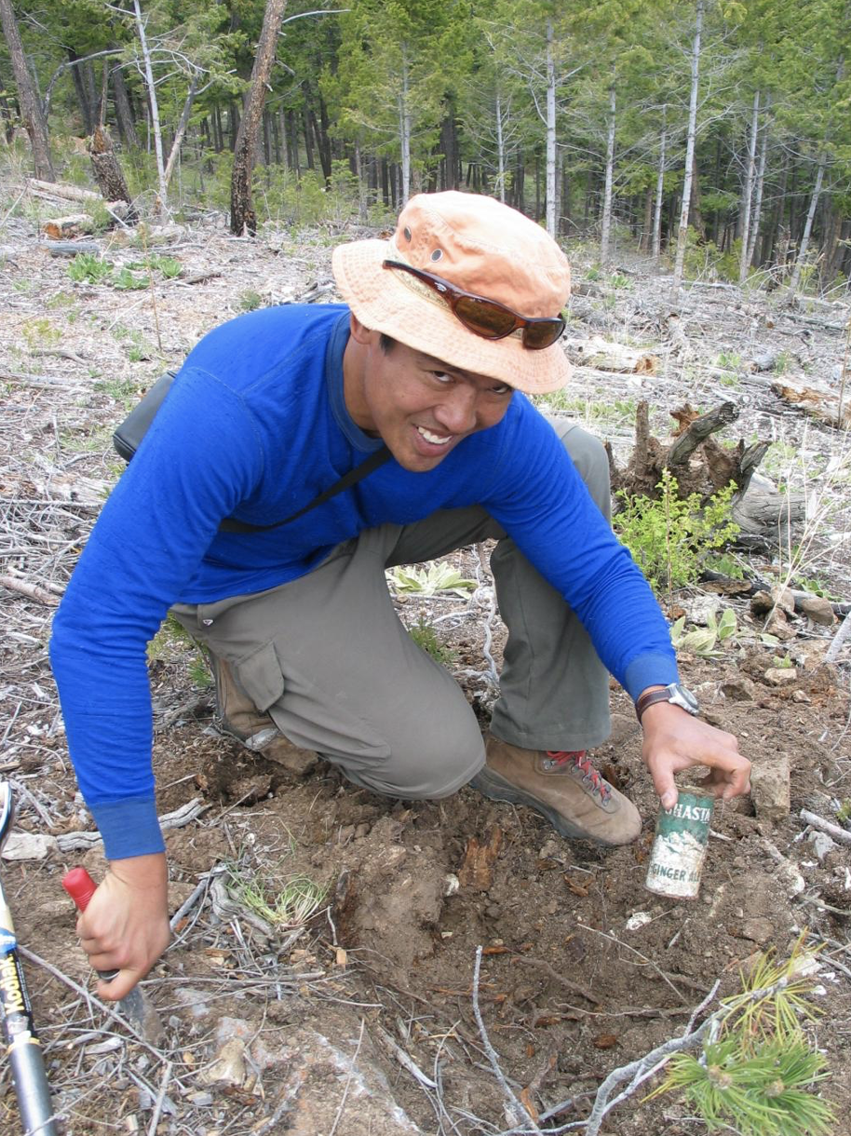
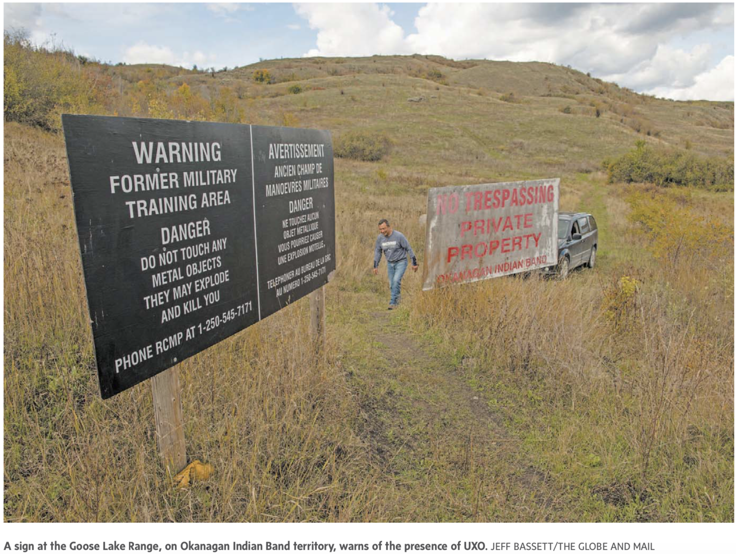
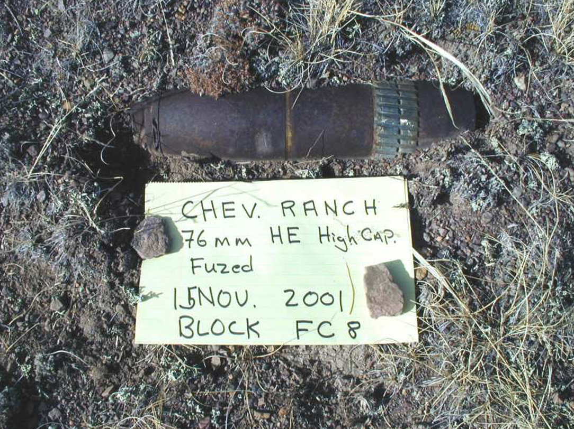
unexploded ordnance: small scales
near surface (or seafloor), need to detect & classify UXO vs clutter
?
UXO
Not UXO
Mortar
76 mm
popcan

Slide 23
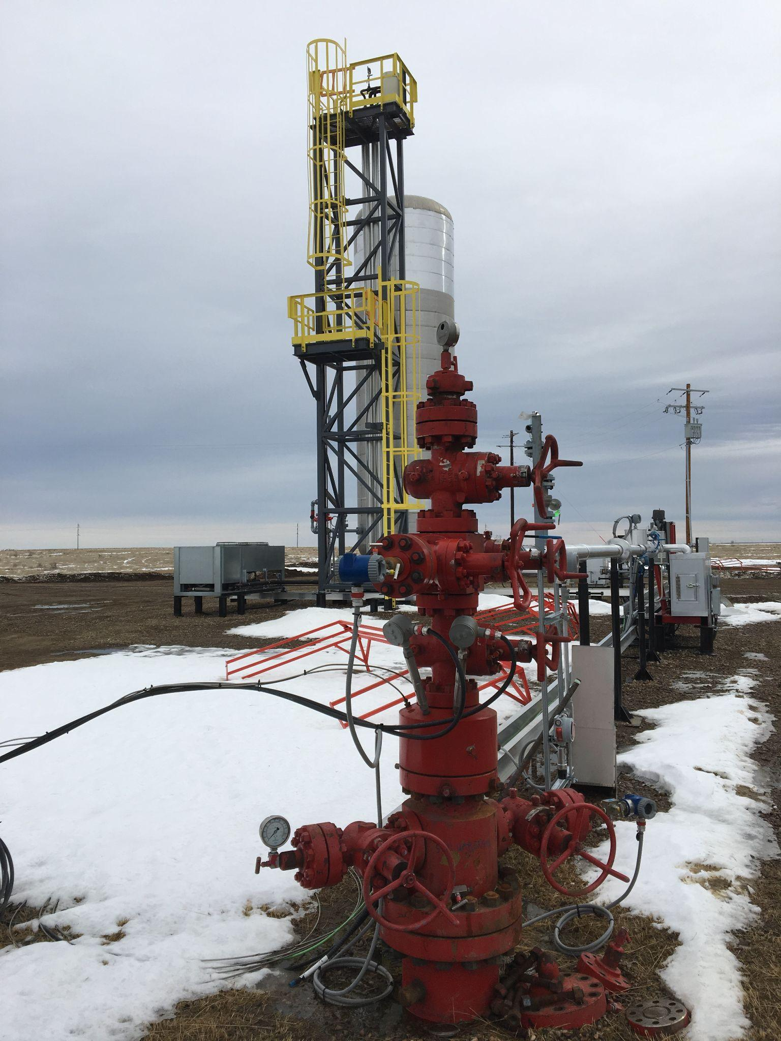
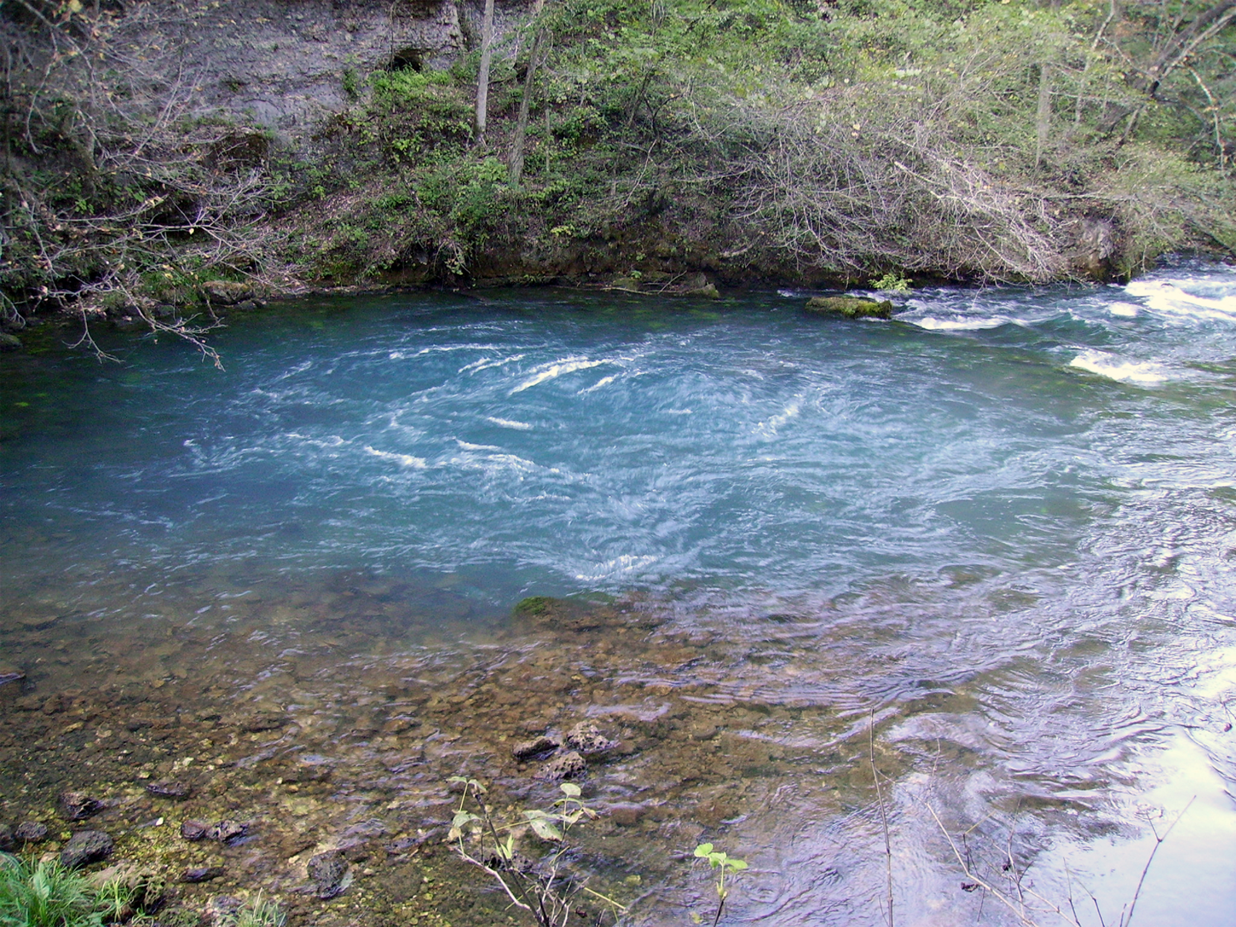

case studies
groundwater
unexploded ordnance
CO₂ sequestration

Slide 24
case studies
groundwater
unexploded ordnance
CO₂ sequestration

Slide 25

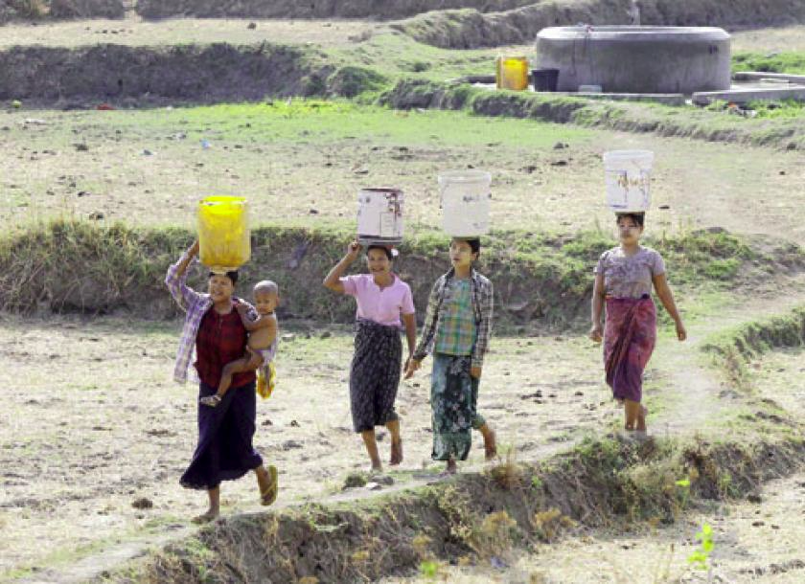










groundwater in Myanmar
Improving Water Security in Mon state, Myanmar via Geophysical Capacity Building
Bring geophysical equipment to Mon state Myanmar
Train local stakeholders
Provide open-source software & educational resources

Slide 26

groundwater in Myanmar: important components
7 step framework for case studies
Setup
Physical properties
Survey
Data
Processing
Interpretation
Synthesis
Open source software and resources
Jupyter notebook “apps” for concepts and data processing
https://courses.geosci.xyz/gwb2020

Slide 27

groundwater in Myanmar
7 step framework
Setup
Physical properties
Survey
Data
Processing
Interpretation
Synthesis
Phayar Ngoteto Village
In 2018: 1D inversion suggested aquifer at 30-50 m
Well drilled to ~60 m: no significant water
In 2020 (before covid...):
return and conduct a 2D survey

Slide 28

groundwater in Myanmar
7 step framework
Setup
Physical properties
Survey
Data
Processing
Interpretation
Synthesis
Hydrogeological Unit | Resistivity (Ωm)
Alluvium and laterite (dry) | 200-800
Alluvium and laterite (saturated) | 30
Sand aquifer | 50-100
Clay aquitard | 10-20
Bedrock (eg. granite) | 500-1000
Fractured/Weathered bedrock (with fresh water) | 40-400
Main diagnostic:
Water bearing region ~ 40-140 Ωm

Slide 29




groundwater in Myanmar
7 step framework
Setup
Physical properties
Survey
Data
Processing
Interpretation
Synthesis
data plotted in pseudosections
Survey: 2D DC resistivity
Wenner-Schlumberger
Dipole-Dipole

Slide 30



groundwater in Myanmar
7 step framework
Setup
Physical properties
Survey
Data
Processing
Interpretation
Synthesis
Survey: 2D DC resistivity
Wenner-Schlumberger
Dipole-Dipole

Slide 31


groundwater in Myanmar
7 step framework
Setup
Physical properties
Survey
Data
Processing
Interpretation
Synthesis
Inversion: estimate a model of the subsurface

Slide 32

groundwater in Myanmar
7 step framework
Setup
Physical properties
Survey
Data
Processing
Interpretation
Synthesis
2020 Drill Hole

Slide 33

groundwater in Myanmar
2020 Drill Hole
7 step framework
Setup
Physical properties
Survey
Data
Processing
Interpretation
Synthesis
>1000 gph
Field surveys at 23+ villages by engineers, geoscientists in Myanmar
Acquired data, interpreted, spotted drill holes using open source software

Slide 34






open educational resources
https://geosci.xyz
undergrads at UBC
electromagnetics course: 26 locations worldwide
Notes:
30k users for EM geosci, 25k for GPG

Slide 35
case studies
groundwater
unexploded ordnance
CO₂ sequestration

Slide 36


an example: monitoring with steel cased wells
applications: CO₂, geothermal, wastewater injection, …
steel-casing: complicates numerical simulations (highly conductive, magnetic)
but… helpful for bringing current to depth
Cylindrical mesh

Slide 37



electromagnetics: basic equations (quasi-static)
Time
Frequency
Faraday’s Law
Ampere’s Law
No Magnetic Monopoles
Constitutive
Relationships
(non-dispersive)
* Solve with sources and boundary conditions

Slide 38





numerical simulations in SimPEG: frequency domain EM
Continuous equations
Finite volume discretization
Eliminate b to obtain a second-order system in e
(Heagy et al., 2017)

Slide 39

numerical simulations in SimPEG: frequency domain EM

Slide 40


numerical simulations in SimPEG: frequency domain EM
Tensor
Cylindrical
OcTree

Slide 41

EM experiment: no casing

Slide 42

EM experiment with casing

Slide 43


Slide 44

EM monitoring with casing
applications: CO₂, geothermal, wastewater injection, settings with infrastructure…
steel-casing: complicates numerical simulations (highly conductive, magnetic)
but… helpful for bringing current to depth
Heagy & Oldenburg (2022)

Slide 45
case studies
groundwater
unexploded ordnance
CO₂ sequestration

Slide 46

Unexploded ordnance (UXO): A global problem
Definition: a munition that was armed, fired and remains unexploded
Sources:
Regions of military conflict
Munitions and bombing ranges
Avalanche control
Countries significantly impacted by UXO

Slide 47

Notes:
Cost of clearing in canada: in $100’s millions

Slide 48




Time-domain EM response of a UXO
UXO
L1
L2 = L3
not UXO
L1
L2 ≠ L3
time

Slide 49
Time-domain EM response of a UXO
UXO
L1
L2 = L3
not UXO
L1
L2 ≠ L3
traditional approach: use inversion to get these and then
classify by comparing L(t) with ordnance library
time

Slide 50

Survey and system
UltraTEMA-4 system:
4 transmitters
12 receivers (3-component)
27 time channels
Height above seabed: ~1 m
Notes:
Locations accuracy: objective: 95% within 50 cm
Platform altitude: +- 0.3 m for 90%
Platform attitude: +- 5º for 90%
Blind grid for detection and classification (detect targets and reject false alarms)
1.8m x 1.8m loops
Avoid early time channels (but still able to use 150-200 microsecs)

Slide 51






Data
Receiver 1
UXO
cross-track
moving
direction
Receiver 12
time
along-track
Transmitter 1
Transmitter 2
Transmitter 3
Transmitter 4

Slide 52
Data
Receiver 1
UXO
cross-track
moving
direction
Receiver 12
time
along-track
Transmitter 1
Transmitter 2
Transmitter 3
Transmitter 4

Slide 53
Data
Receiver 1
UXO
cross-track
moving
direction
Receiver 12
time
along-track
Transmitter 1
Transmitter 2
Transmitter 3
Transmitter 4

Slide 54
Data
Receiver 1
UXO
cross-track
moving
direction
Receiver 12
time
along-track
Transmitter 1
Transmitter 2
Transmitter 3
Transmitter 4

Slide 55

Can we classify directly from EM data?
Convolutional neural networks (CNNs)
Convolutional filters look at spatial / temporal features in the data
Training EM data for UXO classification:
Available library of ordnance objects with polarizations
Fast geophysical simulations
output
input
https://towardsdatascience.com/a-comprehensive-guide-to-convolutional-neural-networks-the-eli5-way-3bd2b1164a53

Slide 56












Convolutional Neural Networks (CNNs)
Supervised classification problem
provided data with labels, construct a function (network) that outputs labels given input data
Input
Features
Neural network
Class probabilities
predicted
true
Image segmentation

Slide 57






Convolutional Neural Networks (CNNs)
J. Lopez-Alvis
How do we translate these things to the UXO classification problem?
Input
Features
Neural network
predicted
Class probabilities
true
nrx
nx

Slide 58




Defining label masks
Sum of magnitudes
Magnitude for each transmitter
Label mask
receiver
number (nrx)
T1
T2
T3
T4
threshold
color is different
for each class
along track
position (nx)
send back to footprint
of system
For time channel #5
cross track distance (m)
along track distance (m)

Slide 59

Application to a line of data
Input features are created by using a sliding window:
cross track (m)
UXO
along track (m)

Slide 60

Application to a line of data
Input features are created by using a sliding window:
cross track (m)
along track (m)
sliding window

Slide 61

Application to a line of data
Input features are created by using a sliding window:
cross track (m)
along track (m)
Neural network output (class)

Slide 62

Application to a line of data
Input features are created by using a sliding window:
cross track (m)
along track (m)

Slide 63
Application to a line of data
Input features are created by using a sliding window:
cross track (m)
along track (m)
Single acquisition line with three objects (classification results)
cross track
along track

Slide 64



Training dataset: dipole forward model
7 classes:
background
155 mm
105 mm
81 mm
60 mm
40 mm
clutter
# of realizations:
Training (multi-class): 400,000
Validation: 10,000
Randomly assign:
Target class
Location
Orientation
Noise level: approximate from background areas in the field data
1.5 x W
0.5 m
2.5 x W
3 m
W - width of the system

Slide 65


Clutter design
Physics-based parameterization of EM decay:
9 parameters in total:
Estimate values for UXOs in ordnance library
Define a distance threshold
Fill the remaining space with clutter objects

Slide 66

Field data - Sequim Bay test site (2022)
7 acquisition lines
Current workflow requires seawater response removed
Some ISOs present, we used only UXO objects to train (e.g. medium ISO ~ 81mm)

Slide 67



Get correlated noise using a binary classifier
object
get spatially correlated noise from this subset of field data

Slide 68

Classification map (output of CNN)

Slide 69

Predicted labels vs truth labels - field data
ground truth
predicted label

Slide 70
Predicted labels vs truth labels - field data
ground truth
predicted label
Discriminated clutter

Slide 71
Predicted labels vs truth labels - field data
ground truth
predicted label
Discriminated clutter
Did not miss any UXO

Slide 72
Predicted labels vs truth labels - field data
ground truth
predicted label
Discriminated clutter
Did not miss any UXO
Classified to closest object in training dataset

Slide 73
UXO classification
Key points:
image-segmentation architecture
clutter design and correlated noise are important
Some limitations:
not trained to handle multiple objects in the same window
objects used to generate synthetic data should be close to the objects on the field
Future work:
explore multi-target scenario
combining with traditional approach

Slide 74

important problems
Electrical conductivity can be a diagnostic physical property in many settings
Electromagnetic methods can be useful across a wide range of scales
Numerical tools for simulation, inversion, machine learning enable understanding of physical responses, invaluable for interpretation of data

Slide 75




Thank you!
simpeg.xyz
geosci.xyz
lheagy@eoas.ubc.ca

